Slide 1
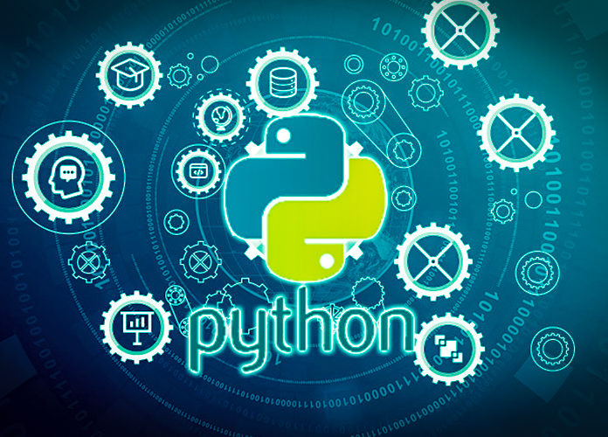
Data Programming in Python _________________ Module 4 Wrap-up

Slide 2
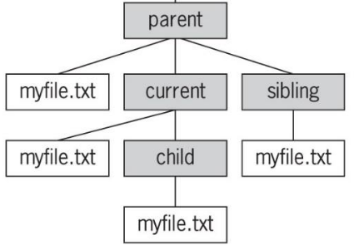
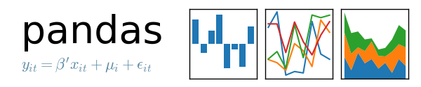
BAIS 6040: Data Programming in Python
Module Objectives:
Reading and Writing Files
Pandas Data Structures
Distinguish between Modules and Packages

Slide 3
BAIS 6040: Data Programming in Python
We learned:
Reading and writing .txt, .csv & .json files
Pandas Series and Dataframes
Directories and File Paths
Python modules and packages

